Slide 1
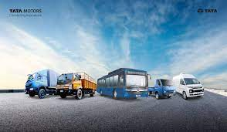
RENT & GO (VECHILE RENTAL SYSTEM)
2010030180-ABHIRAM.V
2010030168-TAHSEEN BEGUM
2010030142-R.VIVEK VARDHAN REDDY
2010030394-ALWALA RAGHAVENDRA GOUD
MENTOR’S
Mr. Chanda Raj Kumar Rao
Dr. K Srinivas

Slide 2
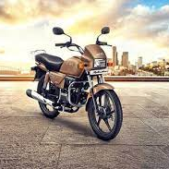
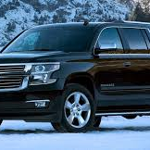
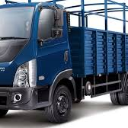
TABLE OFCONTENT
PROBLEM STATEMENT
LITERATURE SURVEY
TOOLS
CODE
RESULTS
GIT-HUB
CONCLUSION
FUTURE ENHANCEMENTS

Slide 3
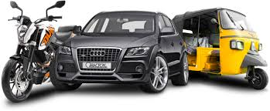
PROBLEM STATEMENT
THIS SYSTEM IS BASED ON A CONCEPT TO RENT CARS AND GENERATE RENTAL INVOICE OF A
RENTAL COMPANY. BEFORE STEPPING INTO THE MAIN SYSTEM A USER HAS TO PASS THROUGH A
LOGIN SYSTEM TO GET ACCESS, THEN ONLY THE USER CAN SELECT CARS WITH A DIFFERENT
MODEL AND RENT FOR CERTAIN DAYS. THIS MINI PROJECT CONTAINS LIMITED FEATURES, BUT THE
ESSENTIAL ONE. TALKING ABOUT THE FEATURES OF THIS RENTAL SYSTEM, AFTER LOGGING IN AS
A USER HE/SHE HAS TO PROVIDE A NAME THEN THE USER CAN SELECT AVAILABLE CARS. AFTER
SELECTING A CAR, THE SYSTEM DISPLAYS SELECTED CAR DETAILS WHICH CONTAIN MAXIMUM
POWER, MILEAGE AND MANY MORE. THEN THE USER HAS TO PROVIDE INFORMATION SUCH AS
NUMBER OF DAYS TO RENT THE CAR. AFTER ALL THESE PROCEDURES, THE SYSTEM CALCULATES
RENT AND DISPLAYS CUSTOMER INVOICE PRESENTING INVOICE NUMBER, CUSTOMER’S NAME,
CAR MODEL, NUMBER, NUMBER OF DAYS AND TOTAL RENTAL AMOUNT.

Slide 4

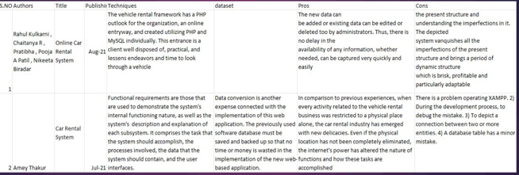
LITERATURE SURVEY
Subtitle

Slide 5

TOOLS
Java web API’s
My-Sql
Eclipse
Jsp
Spring Boot

Slide 6
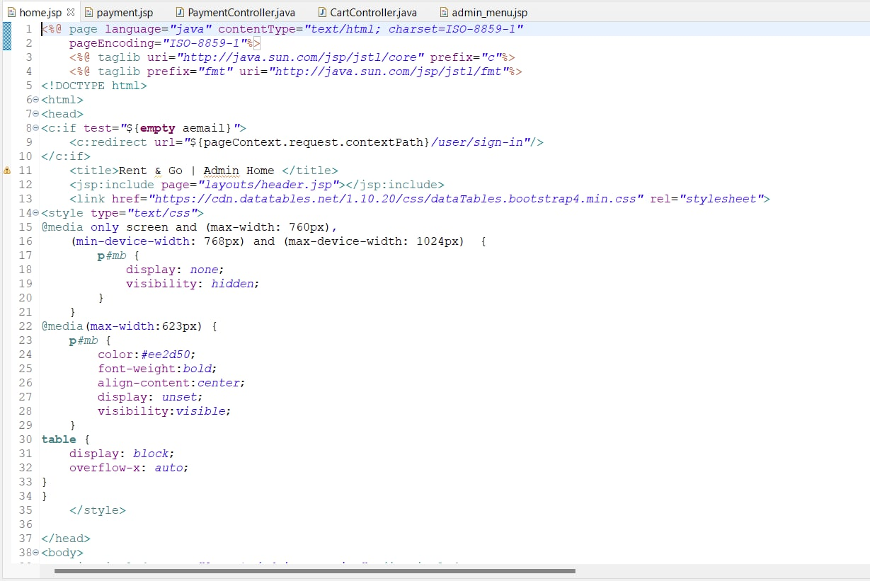
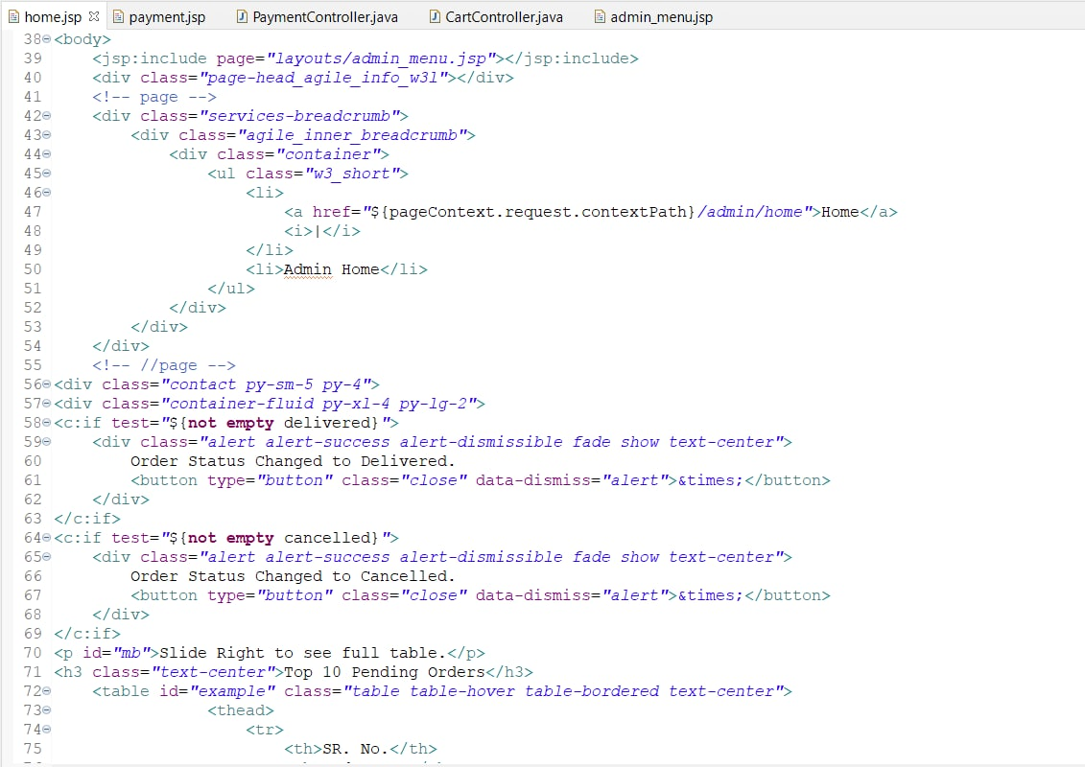
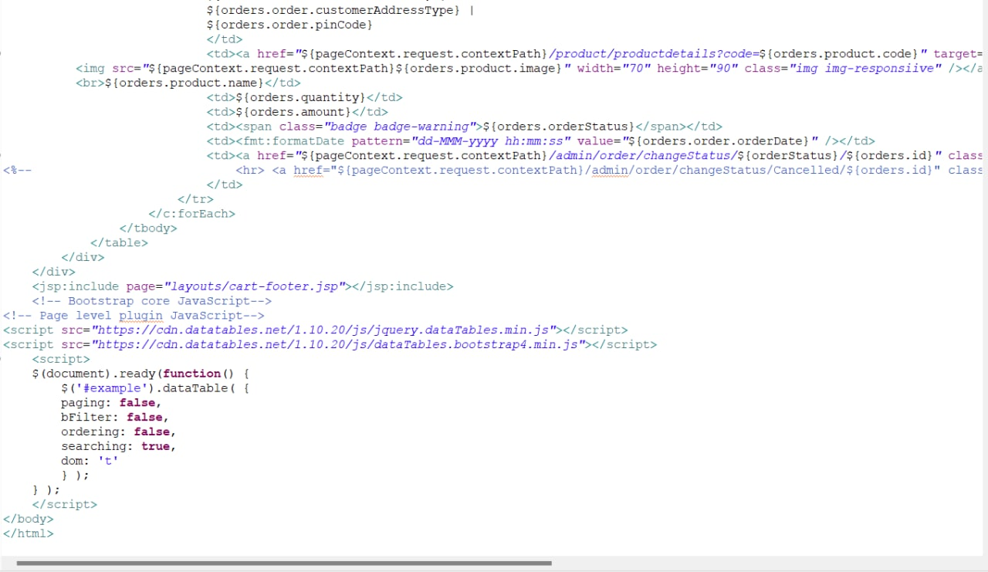
CODE

Slide 7
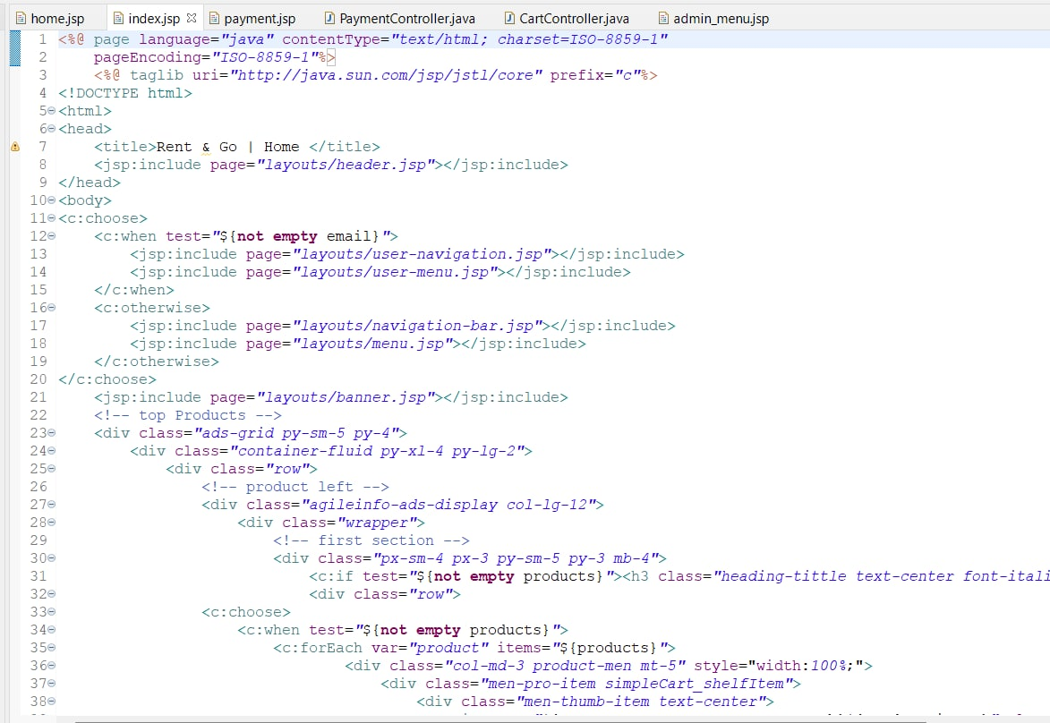
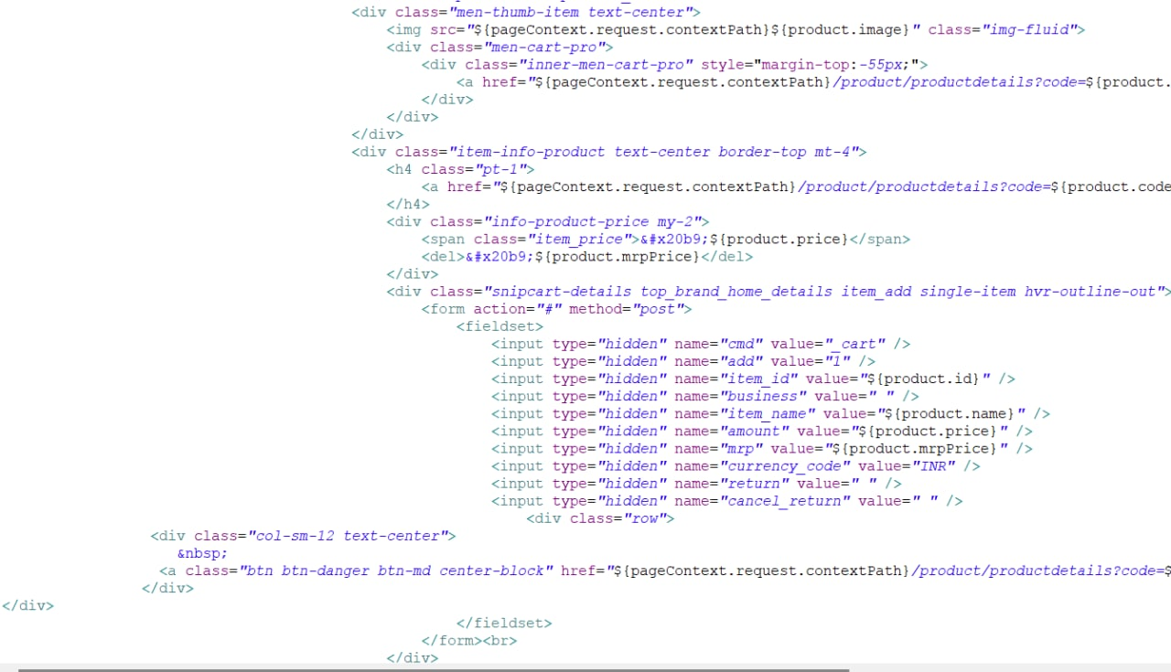
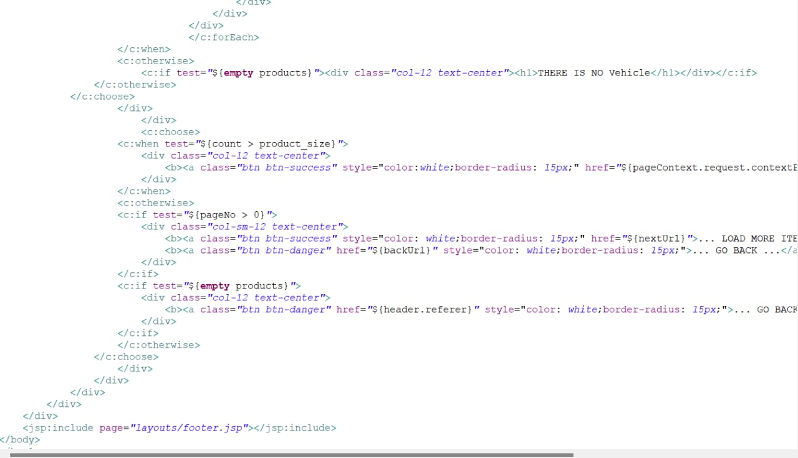

Slide 8
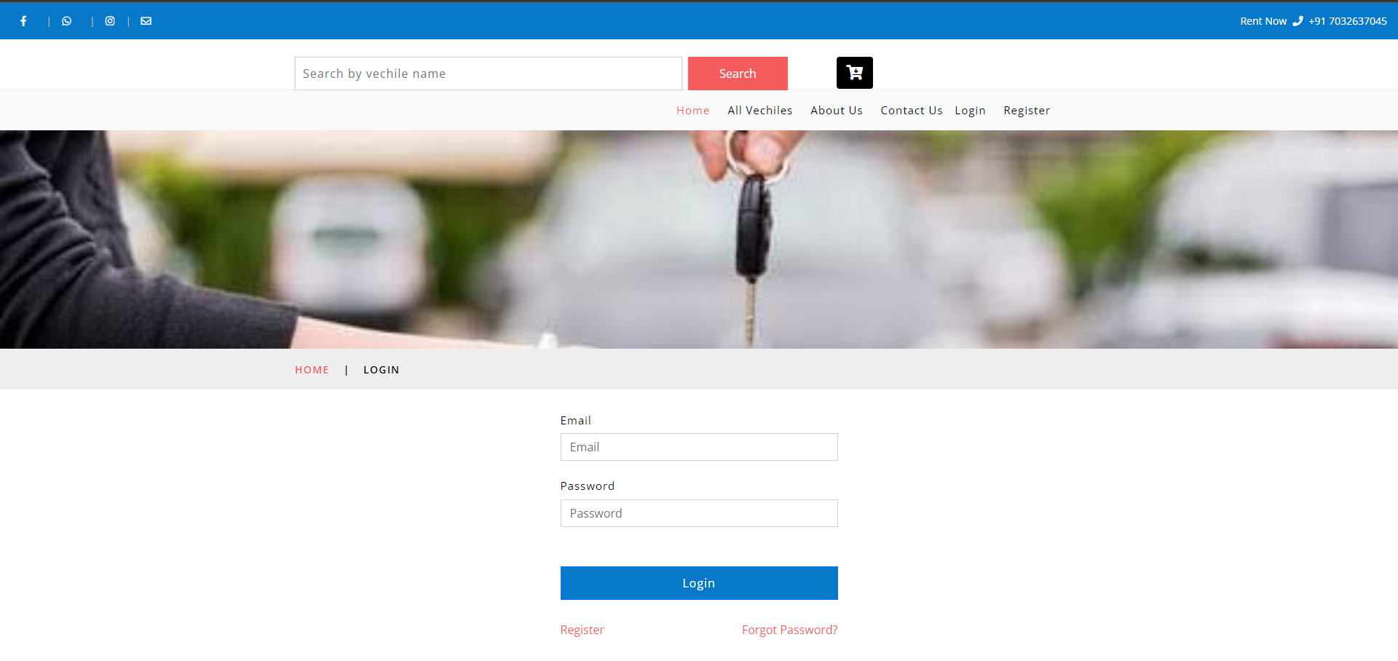
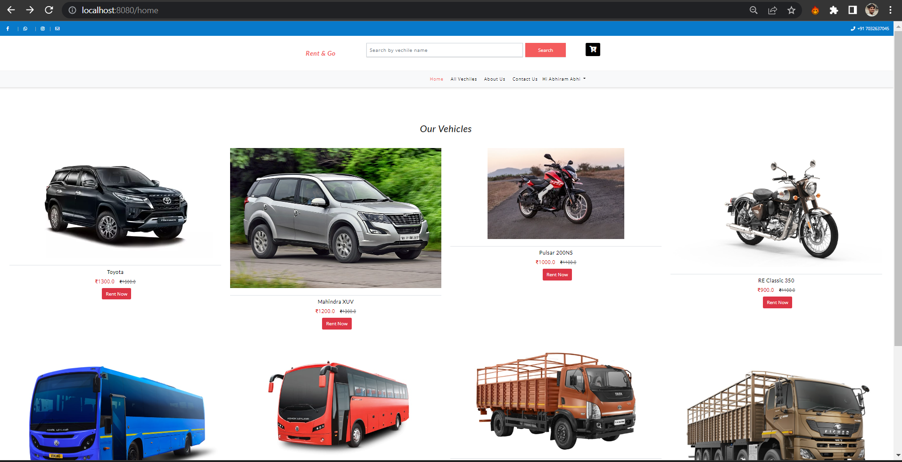
RESULTS

Slide 9
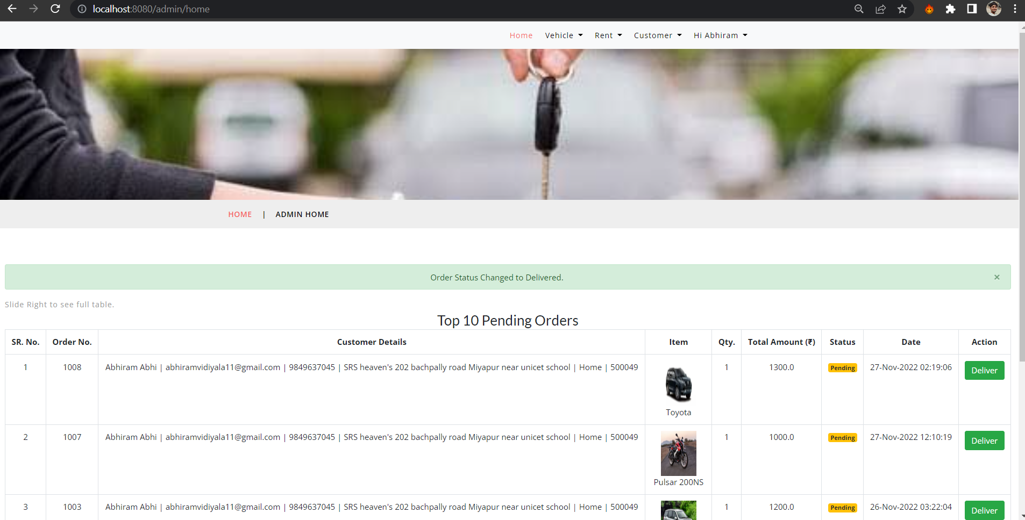
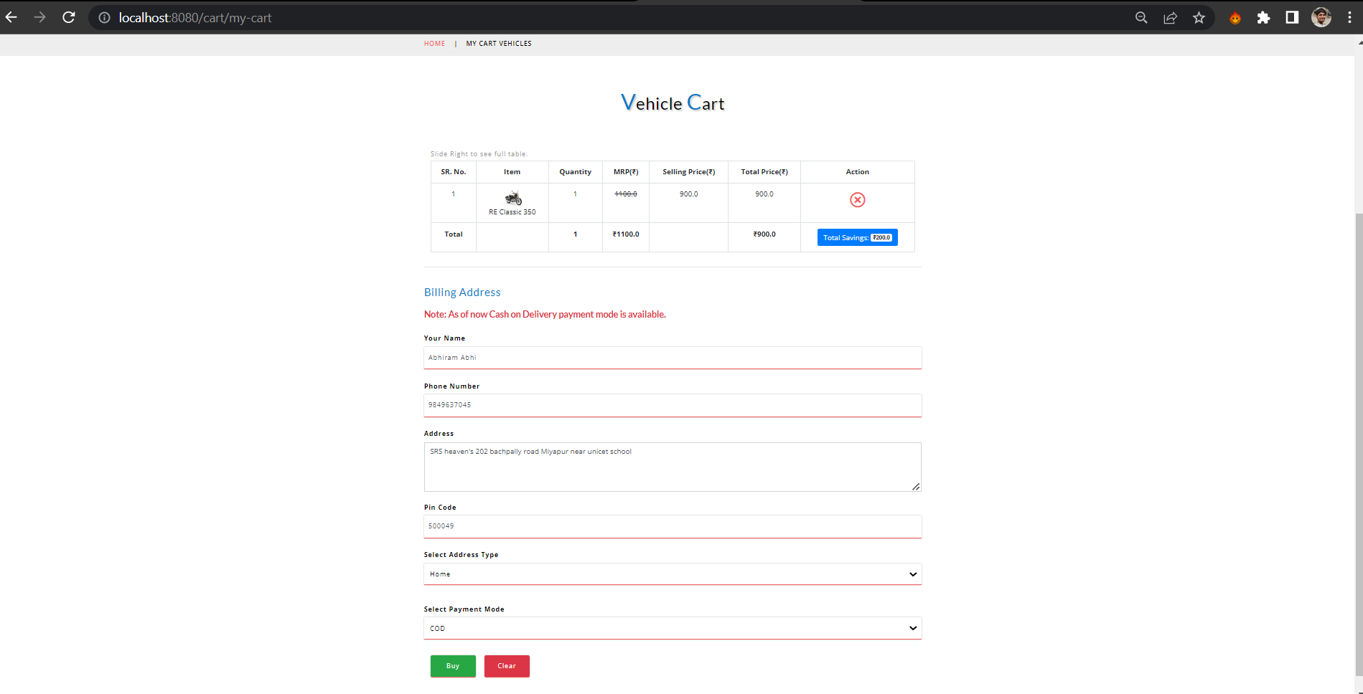
RESULTS

Slide 10
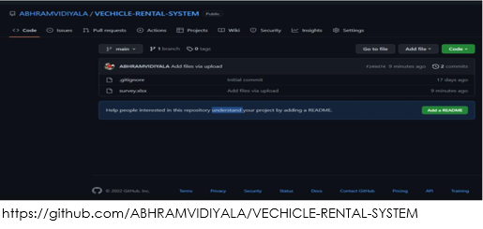
GIT-HUB

Slide 11
Conclusion
Summarizing the above presentation, for the concept of renting cars and
generating rental invoice of a rental company ,we have done a front end
with a good user Summarizing the above presentation, for the concept of
renting cars and generating rental invoice of a rental company ,we have
done a front end with a good user interface using tools like eclipse ide and
java web api. This way we can rent vehicles according to our requirements.

Slide 12
FUTURE ENHANCEMENT
EMAIL VERFICATION
AGE VERIFICATION
OTP GENERATION
INCREASE IN ACURACY
MORE MODES OF PAYMENTS

Slide 13
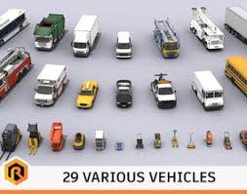
THANKYOU

